Slide 1

AngularJS @ OC-PHP
Brad Green
Manager-guy of AngularJS
Notes:
\

Slide 2
The Principles
Boilerplate
D.R.Y.
Structure
Testability

Slide 3

Project
Results
17,000 LOC
1,500 LOC
Before
with Angular

Slide 4
<div>
<span>
<ul>
RAM
Database
<li>
<li>
<li>

Slide 5
Data Binding
Eureka: DOM
<html ng-app>
<body>
<input ng-model='user.name'>
<p ng-show='user.name'>Hi {{user.name}}</p>
<script src='angular.js'></script>
</body>
</html>

Slide 6
{{ databinding }}
<div>
Logic
RAM
<span>
<ul>
<li>
<li>
<li>

Slide 7
MVC
<html ng-app>
<body ng-controller='UserCtrl as uCtrl'>
Hi <input ng-model='uCtrl.user.first'>
<button ng-click='uCtrl.bye()'>bye</button>
<script src='angular.js'></script>
<script src='UserController.js'></script>
</body>
</html>
function UserCtrl() {
this.user = {
first:'Larry',
last:'Page'
};
this.bye = function() {
alert('bye:' + this.user.first);
};
}
mvc.html
UserController.js

Slide 8
Structure
<div>
UI / View
(DOM)
Observes
Data / Model
(JS Objects)
<span>
<ul>
RAM
<li>
Notifies
Manages
Logic / Controller
(JS Classes)
Notes:
Look at the arrows
Logic can be instantiated without view
View is declarative

Slide 9
Dependency Injection
function UserController(voiceSynth) {
this.user = { first:'Larry', last: 'Page' };
this.bye = function() { voiceSynth.say('bye') };
}
function VoiceSynth(webAudio) {
this.say = function(text) {// do Web Audio stuff};
};
var myApp = angular.module('myApp', []);
myApp.controller('UserController', UserController);
myApp.service('voiceSynth', VoiceSynth);
Module: myApp
View (DOM)
UserController
VoiceSynth
WebAudio

Slide 10
Dependency Injection: Mocking
function VoiceSynthMock() {
this.say = function(text) {
this.said.push(text);
};
this.said = [];
};
var myMocks = angular.module('myMocks', ['myApp']);
myApp.service('voiceSynth', VoiceSynthMock);
Module: myMocks -> myApp
View (DOM)
UserController
VoiceSynth
VoiceSynthMock
WebAudio

Slide 11
Imperative
Declarative
{{ databinding }}
ng-hide
ng-controller
ng-model
Eureka!!!
my-tab
my-pane
my-map
Notes:
Imperative for logic
Declarative for templates and configuration

Slide 12
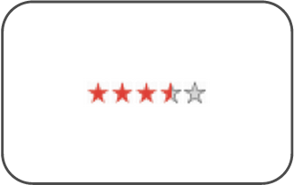
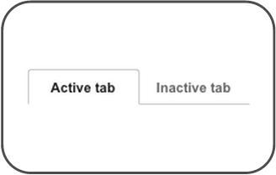
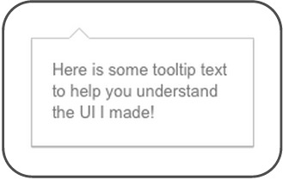
Directives as Components
<rating max="5" model="stars.average">
</rating>
<tabs>
<tab title="Active tab">...</tab>
<tab title="Inactive tab">...</tab>
</tabs>
<span tooltip="{{messages.tip1}}">

Slide 13
Focus Directive
var mod = angular.module('myApp', []);
mod.directive('focus', function() {
return {
link: function(scope, element, attrs) {
element[0].focus();
}
};
});
<form name='myForm'>
<input ng-model='user.firstName' focus>
<input ng-model='user.lastName'>
...
</form>
FocusDirective.js
focus-me.html

Slide 14
Views & Routes
http://coolapp.com/my/view
Static Nav Bar
Static Nav Bar
Dynamic View

Slide 15
Views & Routes
<html ng-app='AMail'>
<body>
<h1>A-Mail</h1>
<ng-view></ng-view>
<script src='angular.js'></script>
<script src='angular-route.js'>
</script>
<script src='app.js'></script>
...etc...
</body>
</html>
function emailRouteConfig($routeProvider) {
$routeProvider.
when('/', {
controller: MessageListController,
templateUrl: 'list.html'
}).
when('/view/:id', {
controller: MessageDetailController,
templateUrl: 'detail.html'
}).
otherwise({ redirectTo: '/' });
}
angular.module('AMail', []).config(emailRouteConfig);
index.html
app.js

Slide 16
Animations made simple
Declaratively add animations to your App
Supports CSS animations & transitions (/w JS fallback)
CSS controls animation life-cycle
Orchestrates DOM changes (add / move / remove)
Keeps track of timing & applies classes
Gracefully degrade on old browsers (JS fallback)

Slide 17
Animate
<div ng-init="items=['angry aardvark','bombastic bear','cantankerous camel','debilitated dingo','ephemeral elephant','fanciful flamingo','gregarious gorilla','haunting horse','impish iguana']">
<input placeholder="Filter Repeat Items..." ng-model="f" />
<div data-ng-repeat="item in items | filter:f track by item" class="my-repeat-animation">
{{item}}
</div>
</div>
.my-repeat-animation.ng-enter,
.my-repeat-animation.ng-leave,
.my-repeat-animation.ng-move {
transition: 0.5s linear all;
position:relative;
}
.my-repeat-animation.ng-enter {
left:-10px;
opacity:0;
}
...
animate.html
animate.css

Slide 18




Tools
Batarang

Slide 19


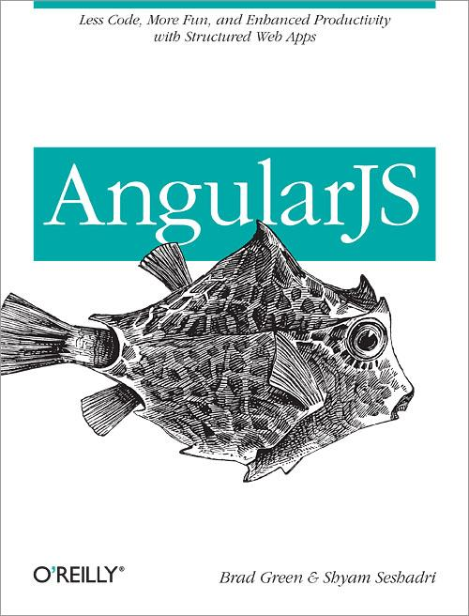
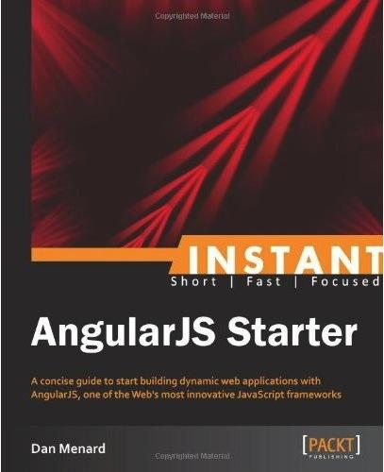




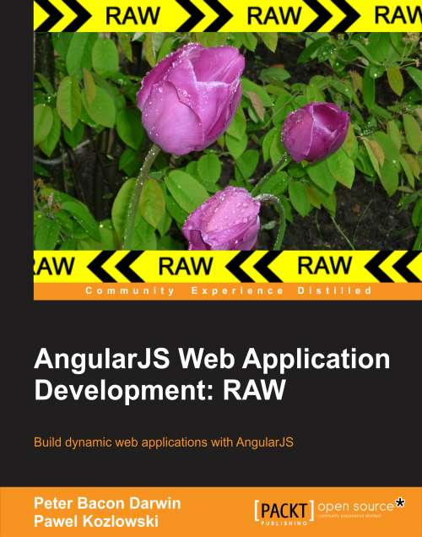
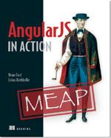


Ecosystem
Tools
UI Components
Libraries
Books
Batarang
AngularUI

Slide 20
Getting Started
AngularJS Tutorial
Dan Wahlin's 60-minute video
Egghead.io
AngularJS Magazine

Slide 21
Thank You!
angularjs.org
Follow on G+ & Twitter
@angularjs
@bradlygreen
Find this presentation at:
http://goo.gl/wYTA2w
Notes:
https://github.com/mhevery/ng-google-io/commits/master

